Slide 1
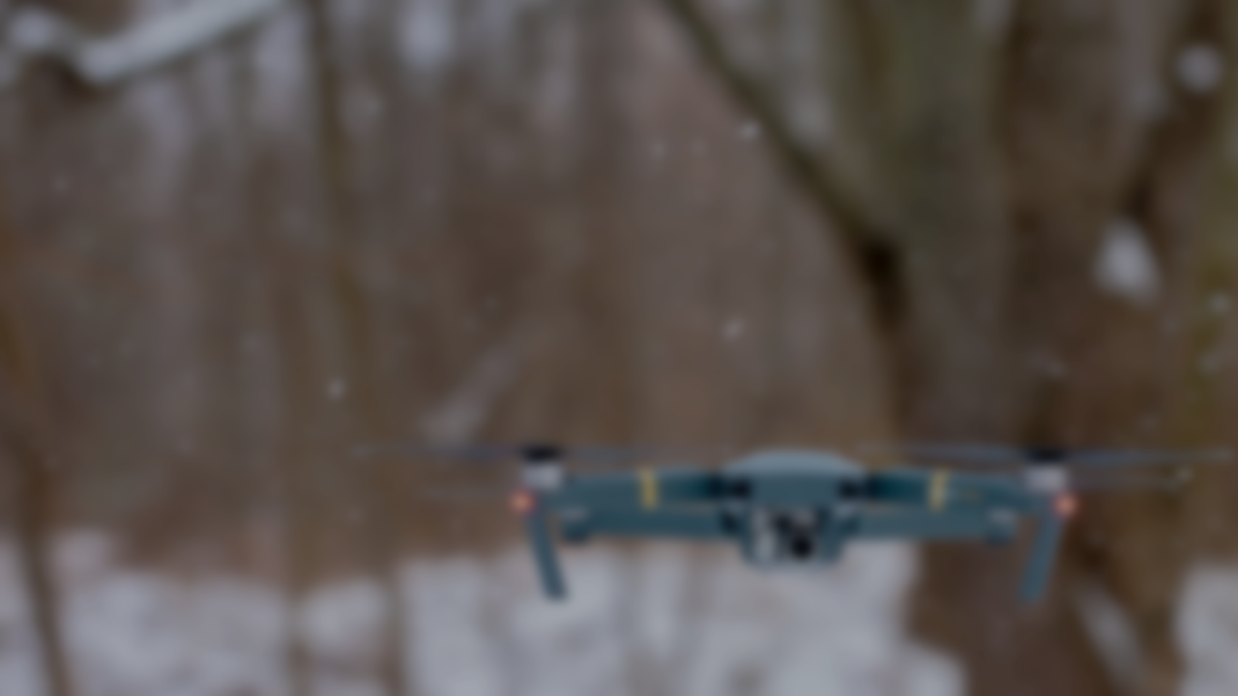
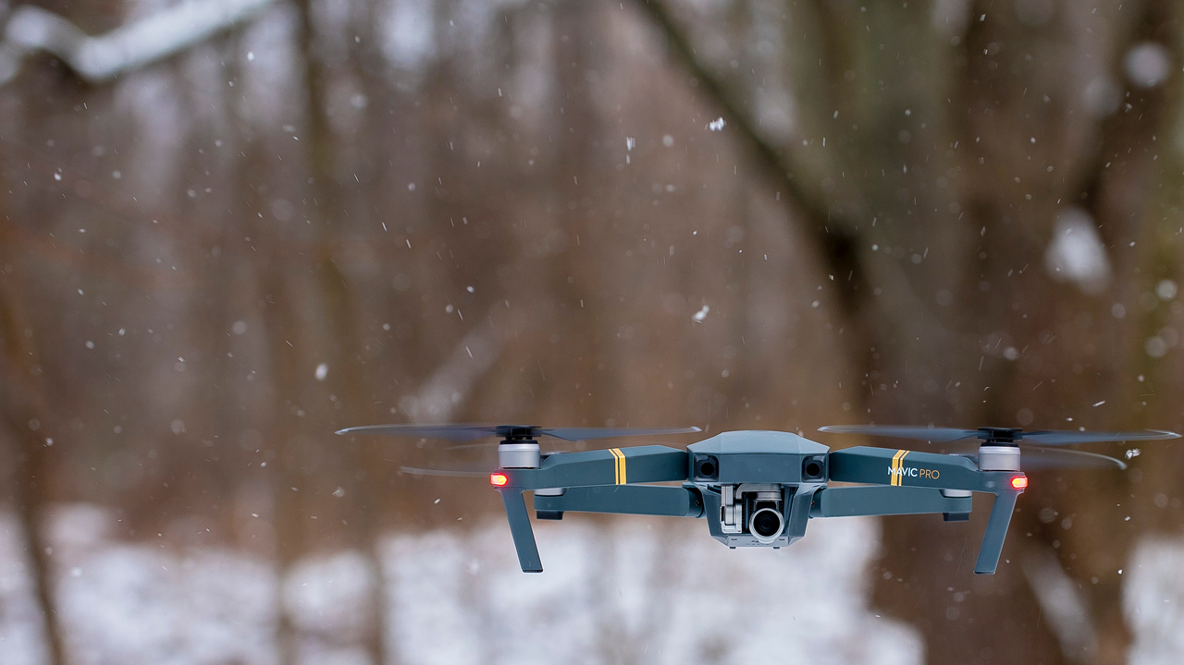
Drone Localization in Ad-hoc Indoor Environment
Marcell Rausch

Slide 2
Challenges of autonomous indoor navigation of drones
No external positioning infrastructure available - GPS
Unknown environment
Building a map of surroundings
Finding the drone position on the built map

Slide 3
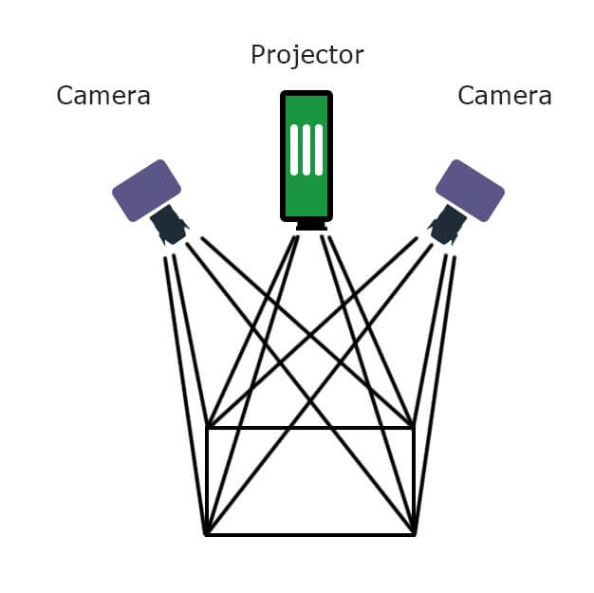
Data acquisition – Visual
Monocular camera
Stereo camera
RGB-D camera

Slide 4
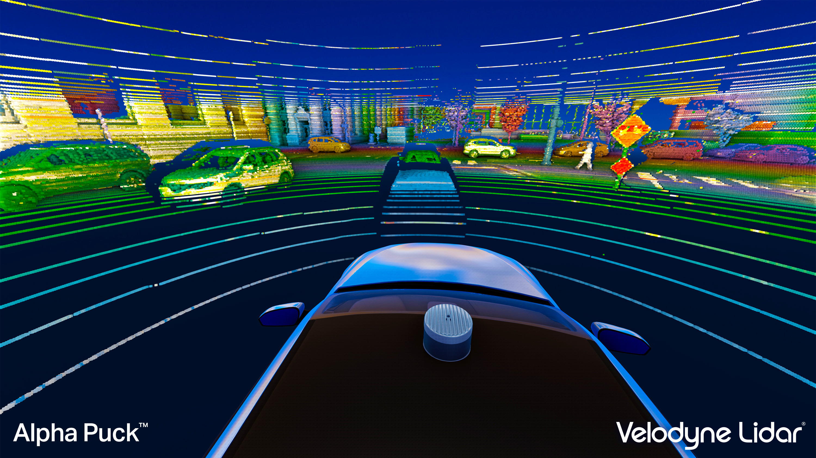
Data acquisition – Ranging sensor
Ultrasonic sensor
High SNR
LIDAR
Smaller than ultrasonic sensors
Down to cm level precision
100m range

Slide 5
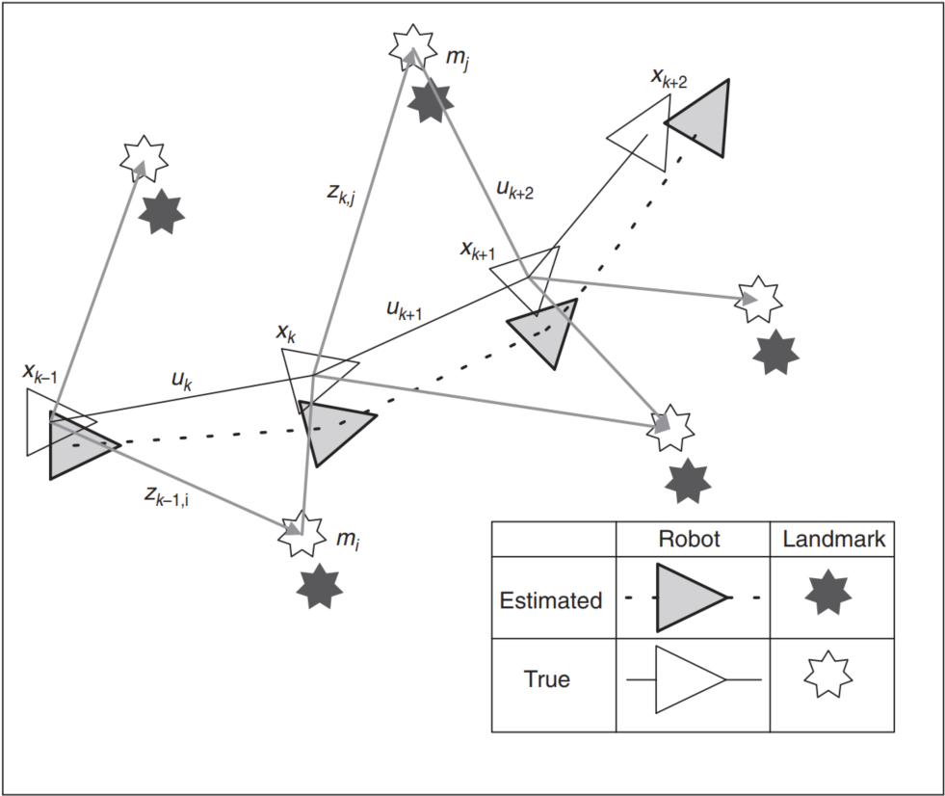
Simultaneous Localization And Mapping
Proposes the issue of simultaneously localizing a robot and mapping its environment
The robot makes relative observations of a number of landmarks using sensors
Estimates its trajectory and location of landmarks

Slide 6
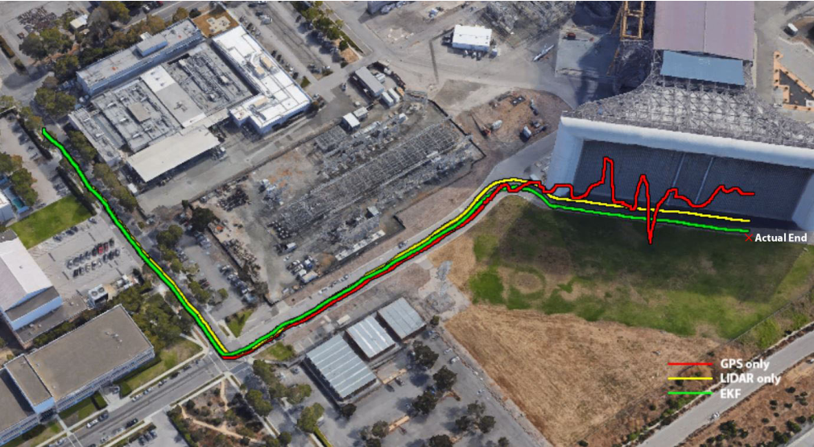
SLAM solutions – Improve position accuracy
LIDAR SLAM as additional input
Fusion of GPS, IMU and LIDAR SLAM
Adaptive Extended Kalman Filter

Slide 7
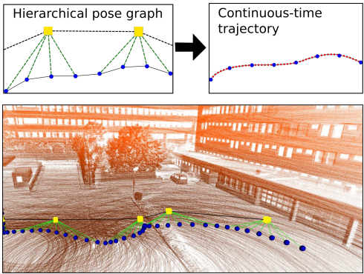
SLAM solutions – Improve online mapping accuracy

Slide 8
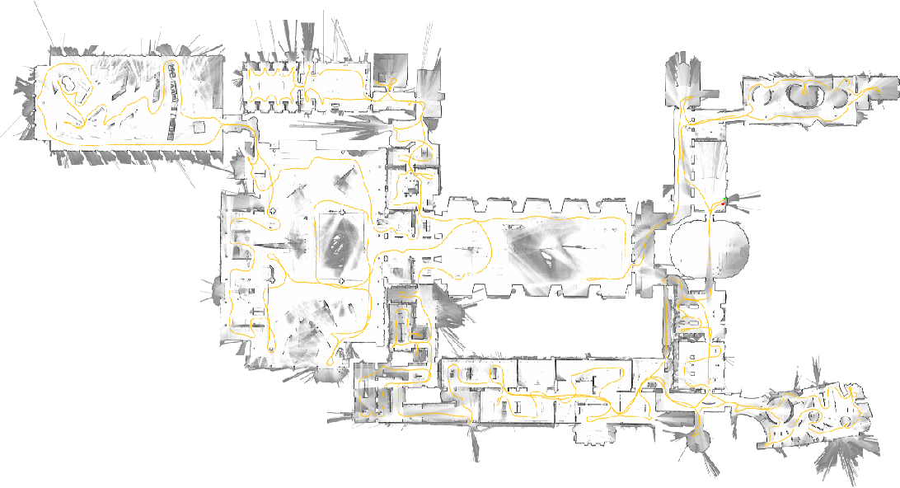
Google Cartographer SLAM

Slide 9
Simulation
ROS
Gazebo
PX4
Pixhawk 4

Slide 10
Initial design
VL53L1X

Slide 14
Thank you for your attention!

